Slide 1

自动驾驶论文讲坛： 一种模块化的可替代传感器融合办法
本周分享
ULM大学的自动驾驶项目旨在提供一种基于概率的不依赖于传感器的融合办法：将环境感知分为栅格地图，自定位和目标跟踪三个模块，各模块之间单向传输数据，传感器的改变不需要修改算法。
星期五 10/11/2017
北京时间 12:00 PM
线上会议直播 - Zoom.us
主讲人：李英实博士

Slide 2
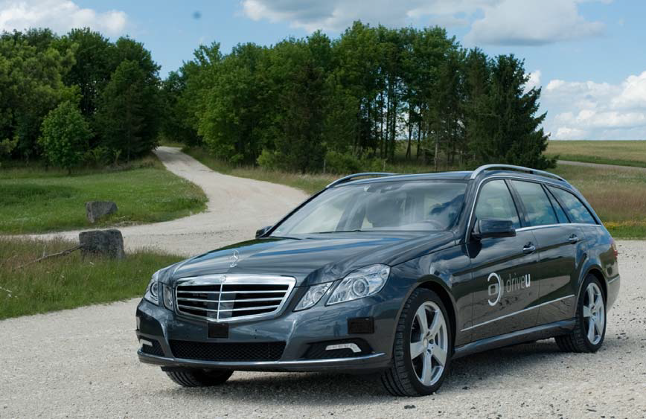
Autonomous Driving at Ulm University
Authors are with the Institute of measurement， control， and Microtechnology，Ulm University， Germany

Slide 3
Introduction
A multi-sensor setup for environmental perception.
The possibility to replace sensors without changing the core of fusion system.
Centralized sensor fusion provides more accurate tracking results since no information is lost, compare to tracking to tracking fusion.
A modular sensor fusion system with generic interfaces.

Slide 4
System Setup
The car modification:
Steer by wire;
Modification of the ESP control unit enables to directly specify brake and acceleration torque via CAN bus;
Torque control by a closed-loop controller on a dSpace real-time system;
The dSpace system is responsible for synchronization of the sensor measurements

Slide 5
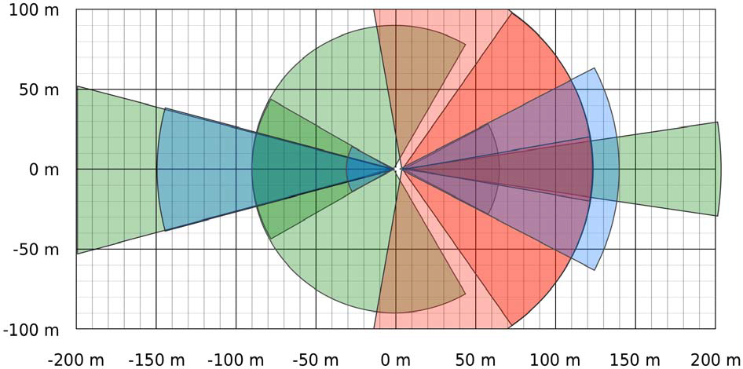
System Setup
Sensor setup: cameras (blue, 1 front, 2 rear), laser scanners (red, 3 front, 1 rear), radar sensors (green, 1 front FMCW, 1 rear LRR, 2 rear MRR)

Slide 6
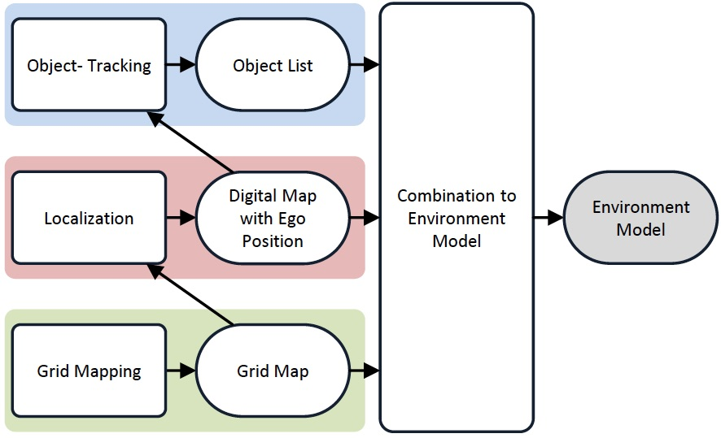
Environment Perception

Slide 7
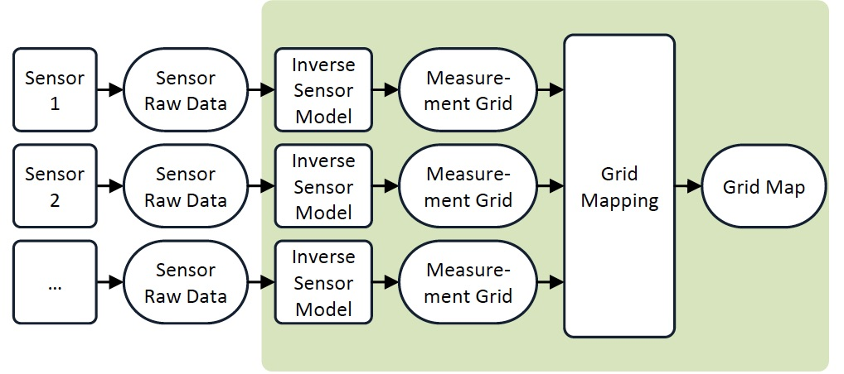
Grid Mapping System
The classical occupancy grid mapping approach
Data from the three laser scanners

Slide 8
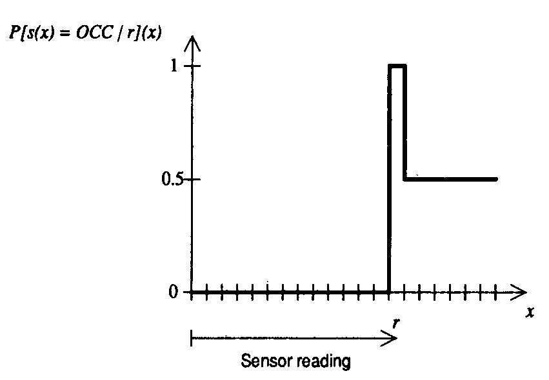
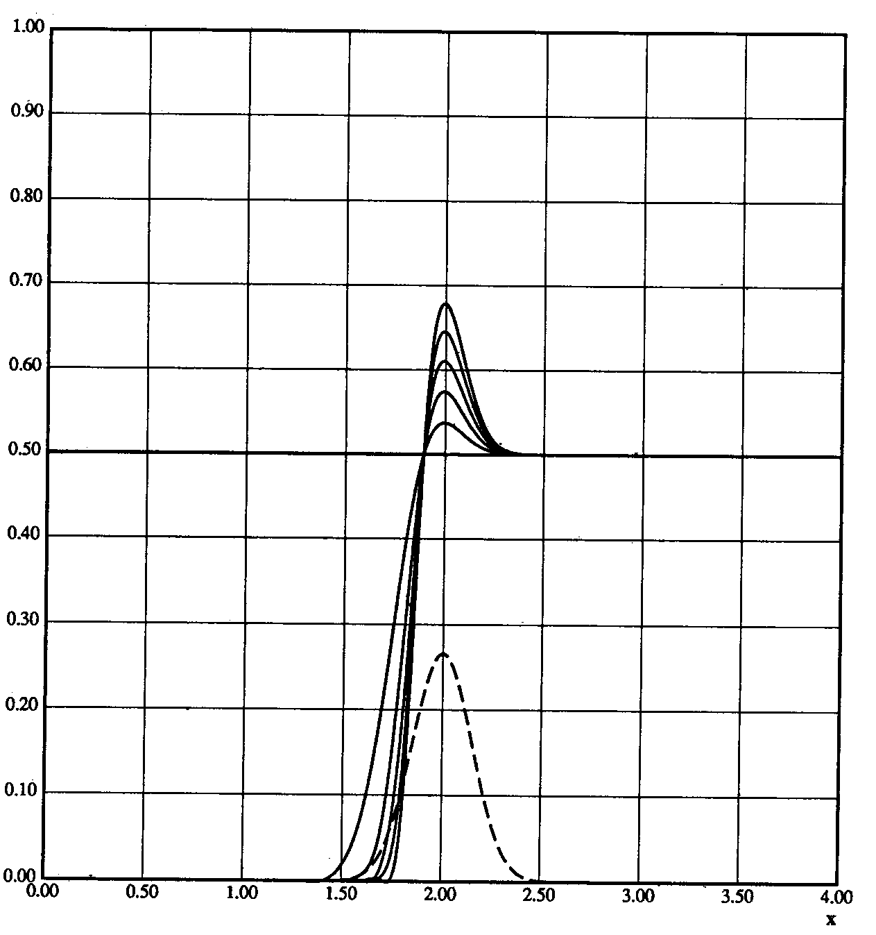

Occupancy Grid Mapping
Cells: empty, occupied, unknown
ideal states
gaussian sensor

Slide 9
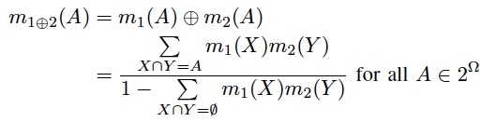
Occupancy Grid Mapping
Vehicle position：RTK + differential GPS， dead reckoning formulation（航迹测算）
Inverse Sensor Model：each grid cell c has its state (occupancy probability), which is the measurement from a camera or a laser sensor. The state of cell c: m(c)
Combination：Bayesian inference or the Dempster-Shafer rule.

Slide 10
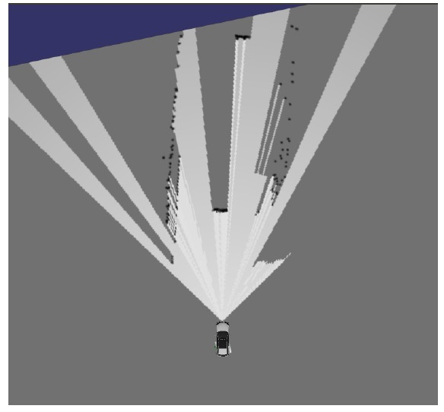
Occupancy Grid Mapping

Slide 11
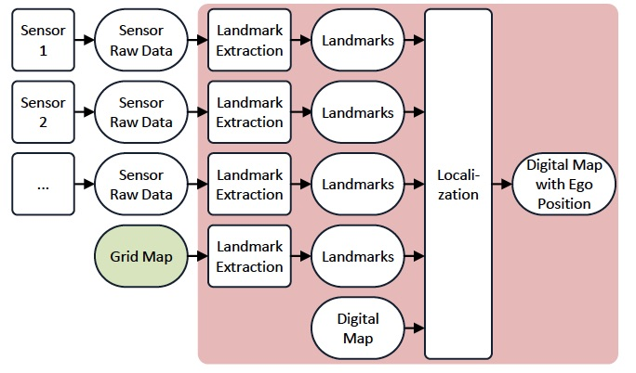
Localization System

Slide 12

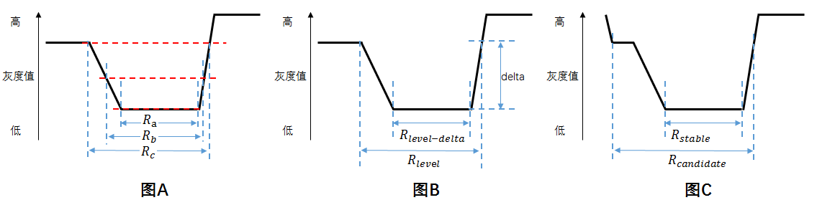
Localization
Landmarks: Lane markings, road signs and tree trunks.
Landmarks detection: using MSER(Maximally stable extremal region) from three laser scanners and a front-facing camera

Slide 13
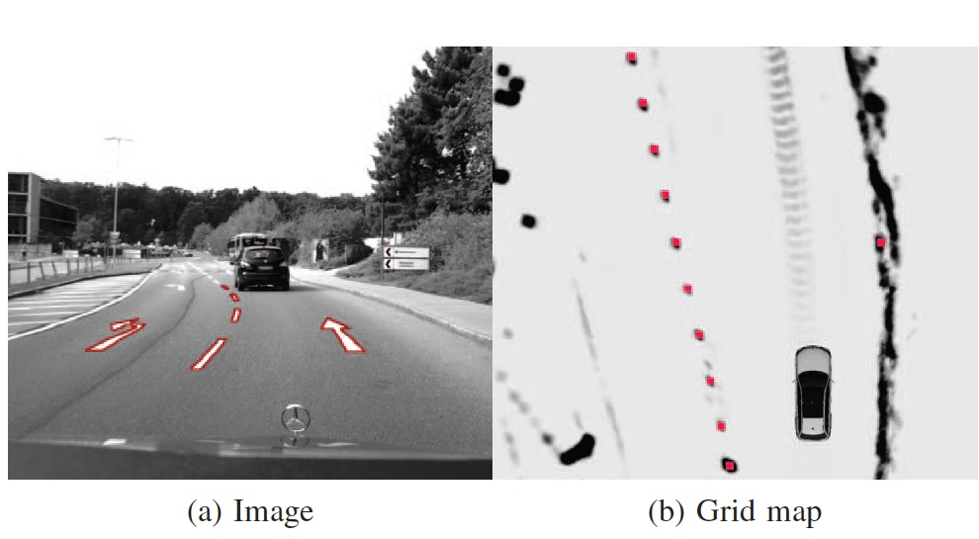
Localization

Slide 14
Localization
~400 Landmarks/kilometer (centroids as global UTM positions) are saved in the database.
Particle filter: Random poses within an uncertainty ellipsoid around the vehicle pose.
Particles are predicted by the dead reckoning formulation.
Weight update.
Average the weighted particles.

Slide 15


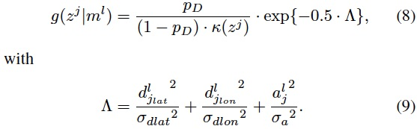



Weight with the landmarks
The set of observations at time k
The set of stored landmark map
The likelihood for a transformed m^{l} and a detection z^{j} is given:
The Munkres algorithm is used to find the optimal association hypothesis θ.
Weight and fusion:

Slide 16
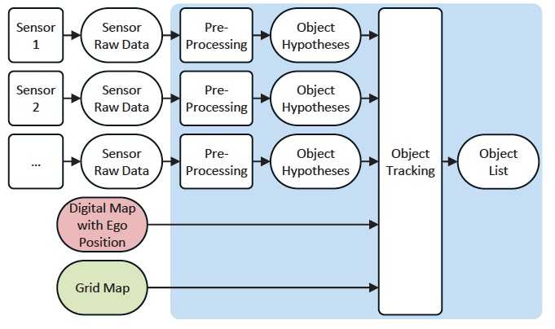
Object Tracking System

Slide 17
Multi-Object Tracking
Vehicles Data from radar, laser and video sensor.
Random finite sets.
The Labeled Multi-Bernoulli(LMB) filter outputs an object list containing the spatial distribution and the existence probability of each track.
A second LMB filter for other road users like pedestrians and bikes using laser and video measurements.

Slide 18
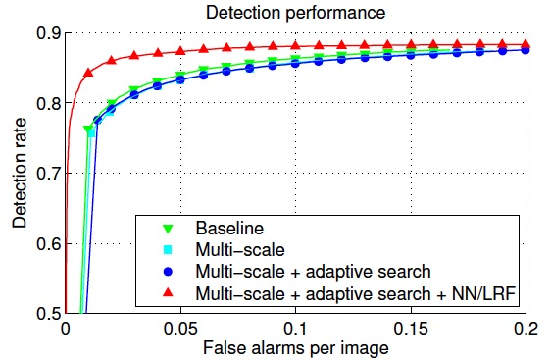
Vehicle Detection in Monocular Images

Slide 19

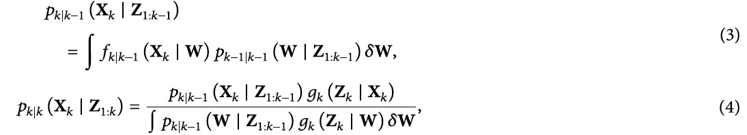
Random Finite Sets
Let 𝑋 and 𝑍 denote the state set and observation set with time-varying cardinalities 𝑁(𝑘) and 𝑀(𝑘) , respectively
The RFS based Bayesian framework for optimal estimation with the multi-target transition density. The random set state transition density and the posterior probability density at time k：

Slide 20
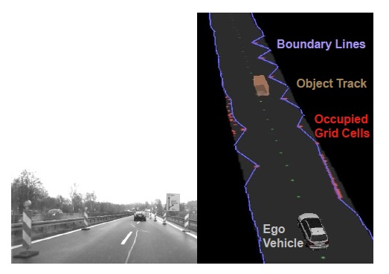
Environment Model
Replace the grid map with boundary lines, which limit the drivable space.
Conservative fallback
behavior
Follow a leading car
Speed Control (max 50-70km/h)

Slide 21
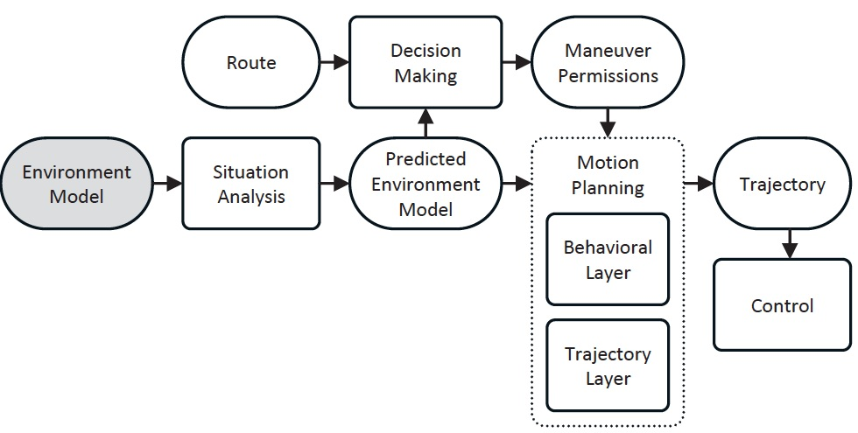
Motion Plan

Slide 22
Results and Conclusion
The 5km test:
The mean LMB state estimation error for the leading vehicle is below 30cm at distances between 30 and 100m.
The ego localization error is below 0.09m, with a standard deviation of less than 0.17m.
Challenging conditions (rain, fog, etc.):
Video camera has a poor performance and object classification is diminished.
The ego localization relies only on laser measurements (error 0.12m, still sufficient).
Expectation:
A highly-precise digital map is needed.
Further improvements of the object tracking module.

Slide 23

iMorpheus Journal Club ( Friday 12:00PM GMT+8, Weekly )
每周五 下午12点 （北京时间）
下周预告：
YOLO9000 : Better, Faster, Stronger
关键词：Real time Object detection, RT Object classification, Wordtree, Joint Training Algorthm
iMorpheus website : www.imorpheus.ai
Email Address : live@imorpheus.ai
微信 Wechat

